Slide 1
Objectives
In this session, you will learn to:
  Summarize and group data

Slide 2

Summarizing and Grouping Data
How can I summarize and group data?

Slide 3

Summarizing and Grouping Data (Contd.)
SQL Server provides aggregate functions to generate summarized data.
Notes:
Student already have learnt about type 2 SCDs in Module I. Therefore, you can start this topic by asking the following questions to students:
What are type 2 SCDs?
Given an example to explain type 2 SCDs.
This will recapitulate what they have learnt about type 2 SCD in Module 1.
Now explain the strategy to update the data into these dimension tables with help the example given in SG.
After explaining the examples, you can ask students to think of an example of a type 2 SCD and then tell the strategy to update the data into this dimension table.

Slide 4
Summarizing Data by Using Aggregate Functions
Aggregate functions:
  Summarize the values for a column or a group of columns, and produce a single value.
  Syntax:
    SELECT aggregate_function([ALL|DISTINCT] expression) FROM table_name
Notes:
Student already have learnt about type 2 SCDs in Module I. Therefore, you can start this topic by asking the following questions to students:
What are type 2 SCDs?
Given an example to explain type 2 SCDs.
This will recapitulate what they have learnt about type 2 SCD in Module 1.
Now explain the strategy to update the data into these dimension tables with help the example given in SG.
After explaining the examples, you can ask students to think of an example of a type 2 SCD and then tell the strategy to update the data into this dimension table.

Slide 5
Summarizing Data by Using Aggregate Functions (Contd.)
  You can calculate summary values by using the following aggregate functions:
    Avg()
    Count()
    Min()
    Max()
    Sum()
Notes:
Student already have learnt about type 2 SCDs in Module I. Therefore, you can start this topic by asking the following questions to students:
What are type 2 SCDs?
Given an example to explain type 2 SCDs.
This will recapitulate what they have learnt about type 2 SCD in Module 1.
Now explain the strategy to update the data into these dimension tables with help the example given in SG.
After explaining the examples, you can ask students to think of an example of a type 2 SCD and then tell the strategy to update the data into this dimension table.

Slide 6
Summarizing Data by Using Aggregate Functions (Contd.)
  Avg():
    Returns the average of values in a numeric expression, either all or distinct.
    For example:
      SELECT 'Average Rate' = avg (Rate) FROM HumanResources.EmployeePayHistory
  Count():
    Returns the number of values in an expression, either all or distinct.
    For example:
      SELECT 'Unique Rate' = count (DISTINCT Rate) FROM HumanResources.EmployeePayHistory
Notes:
Student already have learnt about type 2 SCDs in Module I. Therefore, you can start this topic by asking the following questions to students:
What are type 2 SCDs?
Given an example to explain type 2 SCDs.
This will recapitulate what they have learnt about type 2 SCD in Module 1.
Now explain the strategy to update the data into these dimension tables with help the example given in SG.
After explaining the examples, you can ask students to think of an example of a type 2 SCD and then tell the strategy to update the data into this dimension table.

Slide 7
Summarizing Data by Using Aggregate Functions (Contd.)
  Min():
    Returns the lowest value in the expression.
    For example:
      SELECT 'Minimum Rate' = min (Rate) FROM HumanResources.EmployeePayHistory
  Max():
    Returns the highest value in the expression.
    For example:
      SELECT 'Maximum Rate' = max (Rate) FROM HumanResources.EmployeePayHistory
  Sum():
    Returns the sum total of values in a numeric expression, either all or distinct.
    For example:
      SELECT 'Sum' = sum (DISTINCT Rate) FROM HumanResources.EmployeePayHistory
Notes:
Student already have learnt about type 2 SCDs in Module I. Therefore, you can start this topic by asking the following questions to students:
What are type 2 SCDs?
Given an example to explain type 2 SCDs.
This will recapitulate what they have learnt about type 2 SCD in Module 1.
Now explain the strategy to update the data into these dimension tables with help the example given in SG.
After explaining the examples, you can ask students to think of an example of a type 2 SCD and then tell the strategy to update the data into this dimension table.

Slide 8
Just a minute
What would be the output of the following query?
  SELECT 'Maximum Rate' = max (UnitPrice)
  FROM Sales.SalesOrderDetail
Solution:
  The query displays the maximum unit price from the SalesOrderDetail table.
Notes:
Student already have learnt about type 2 SCDs in Module I. Therefore, you can start this topic by asking the following questions to students:
What are type 2 SCDs?
Given an example to explain type 2 SCDs.
This will recapitulate what they have learnt about type 2 SCD in Module 1.
Now explain the strategy to update the data into these dimension tables with help the example given in SG.
After explaining the examples, you can ask students to think of an example of a type 2 SCD and then tell the strategy to update the data into this dimension table.

Slide 9
Grouping Data
You can group the data by using the GROUP BY, COMPUTE, COMPUTE BY, and PIVOT clauses of the SELECT statement.
Notes:
Student already have learnt about type 2 SCDs in Module I. Therefore, you can start this topic by asking the following questions to students:
What are type 2 SCDs?
Given an example to explain type 2 SCDs.
This will recapitulate what they have learnt about type 2 SCD in Module 1.
Now explain the strategy to update the data into these dimension tables with help the example given in SG.
After explaining the examples, you can ask students to think of an example of a type 2 SCD and then tell the strategy to update the data into this dimension table.

Slide 10
Grouping Data (Contd.)
The GROUP BY clause:
  Summarizes the result set into groups as defined in the SELECT statement by using aggregate functions.
  Uses the HAVING clause to further restrict the result set to produce the data based on a condition.
  Syntax:
      SELECT column_list
      FROM table_name
      WHERE condition
      [GROUP BY [ALL] expression [, expression]
      [HAVING search_condition]
Notes:
Student already have learnt about type 2 SCDs in Module I. Therefore, you can start this topic by asking the following questions to students:
What are type 2 SCDs?
Given an example to explain type 2 SCDs.
This will recapitulate what they have learnt about type 2 SCD in Module 1.
Now explain the strategy to update the data into these dimension tables with help the example given in SG.
After explaining the examples, you can ask students to think of an example of a type 2 SCD and then tell the strategy to update the data into this dimension table.

Slide 11
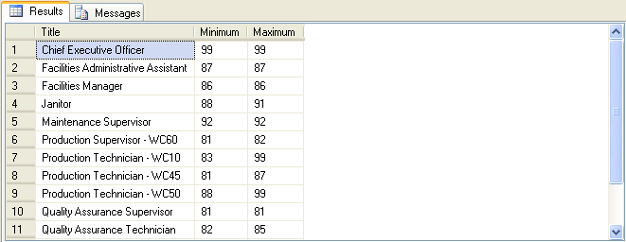
Grouping Data (Contd.)
  For example:
    SELECT Title, Minimum = min(VacationHours), Maximum = max(VacationHours) FROM HumanResources.Employee
    WHERE VacationHours > 80 GROUP BY Title
Output
The minimum and maximum values of vacation hours for the different types of titles
Notes:
Student already have learnt about type 2 SCDs in Module I. Therefore, you can start this topic by asking the following questions to students:
What are type 2 SCDs?
Given an example to explain type 2 SCDs.
This will recapitulate what they have learnt about type 2 SCD in Module 1.
Now explain the strategy to update the data into these dimension tables with help the example given in SG.
After explaining the examples, you can ask students to think of an example of a type 2 SCD and then tell the strategy to update the data into this dimension table.

Slide 12
Grouping Data (Contd.)
COMPUTE and COMPUTE BY:
  The COMPUTE clause is used to generate summary rows by using aggregate functions in the query results.
  The COMPUTE BY clause can be used to calculate summary values of the result set on a group of data.
  Syntax:
    SELECT column_list
    FROM table_name
    ORDER BY column_name
    COMPUTE aggregate_function (column_name) [, aggregate_function (column_name)...]
    [BY column_name [, column_name]...]
Notes:
Student already have learnt about type 2 SCDs in Module I. Therefore, you can start this topic by asking the following questions to students:
What are type 2 SCDs?
Given an example to explain type 2 SCDs.
This will recapitulate what they have learnt about type 2 SCD in Module 1.
Now explain the strategy to update the data into these dimension tables with help the example given in SG.
After explaining the examples, you can ask students to think of an example of a type 2 SCD and then tell the strategy to update the data into this dimension table.

Slide 13
Grouping Data (Contd.)
  For example:
    SELECT Title, 'Total VacationHours' = VacationHours, 'Total SickLeaveHours' = SickLeaveHours FROM HumanResources.Employee WHERE Title IN ('Recruiter', 'Stocker') ORDER BY Title, VacationHours, SickLeaveHours
    COMPUTE SUM(VacationHours), SUM(SickLeaveHours
Notes:
You can summarize the session by running through the summary given in SG.
In addition, you can also ask students summarize what they have learnt in this session.

Slide 14
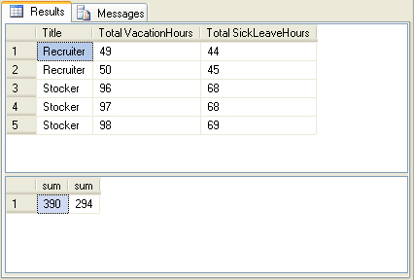
Grouping Data (Contd.)
  The following figure displays the output of the preceding query.
Notes:
You can summarize the session by running through the summary given in SG.
In addition, you can also ask students summarize what they have learnt in this session.

Slide 15
Grouping Data (Contd.)
  The PIVOT clause:
  Is used to transform a set of columns into values.
  Rotates a table-valued expression by turning the unique values from one column in the expression into multiple columns in the output.
  Syntax:
    SELECT * from table_name
    PIVOT (aggregation_function (value_columhe)
    FOR pivot_column
    IN (column_list)
    ) table_alias
Notes:
You can summarize the session by running through the summary given in SG.
In addition, you can also ask students summarize what they have learnt in this session.

Slide 16
Grouping Data (Contd.)
  For example:
    SELECT VendorID, [164] AS Emp1, [198] AS Emp2, [223] AS Emp3, [231] AS Emp4, [233] AS Emp5
    FROM
    (SELECT PurchaseOrderID, EmployeeID, VendorID
    FROM Purchasing.PurchaseOrderHeader) p
    PIVOT
    (
    COUNT (PurchaseOrderID)
    FOR EmployeeID IN
    ( [164], [198], [223], [231], [233] )
    ) AS pvt
    ORDER BY VendorID
Notes:
You can summarize the session by running through the summary given in SG.
In addition, you can also ask students summarize what they have learnt in this session.

Slide 17
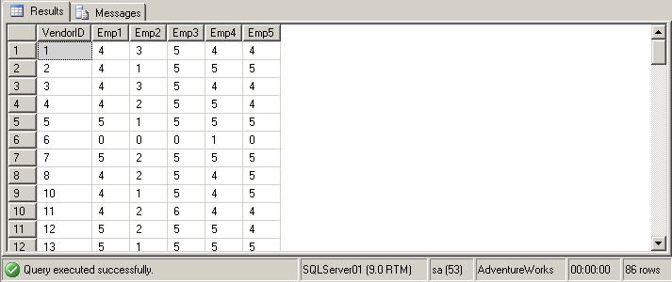
Grouping Data (Contd.)
  The preceding query displays the displays the output, as shown in the following figure.
Query displays the number of purchase orders placed by certain employees, laid down with the vendors.
Notes:
You can summarize the session by running through the summary given in SG.
In addition, you can also ask students summarize what they have learnt in this session.

Slide 18
Just a minute
  When grouping data, which of the following clauses helps eliminate the groups that do not match the condition specified?
  NOT IN
  HAVING
  WHERE
  COMPUTE
  Solution:
  2. HAVING
Notes:
You can summarize the session by running through the summary given in SG.
In addition, you can also ask students summarize what they have learnt in this session.

Slide 19
Just a minute
  Match the column A with column B.
Column A | Column B
ALL | Used by aggregate functions
PIVOT | Returns zero or more values
IN | Used for modifying comparison operator
> | Relational operator
  Solution:
Column A | Column B
ALL | Used for modifying comparison operator
PIVOT | Relational operator
IN | Returns zero or more values
> | Used by aggregate functions
Notes:
You can summarize the session by running through the summary given in SG.
In addition, you can also ask students summarize what they have learnt in this session.

Slide 20
Demo: Summarizing and Grouping Data
Problem Statement:
  You are a database developer of AdventureWorks, Inc. The management wants to view the average quantity ordered for each product group. The data should be displayed in the descending order of ProductID.
  The sales details are stored in the SalesOrderHeader and SalesOrderDetails tables in the AdventureWorks database. How will you generate this report?
Notes:
You can summarize the session by running through the summary given in SG.
In addition, you can also ask students summarize what they have learnt in this session.

Slide 21
Demo: Summarizing and Grouping Data (Contd.)
Solution:
  To solve the preceding problem, you need to perform the following tasks:
    Create a query.
    Execute the query to verify the result.
Notes:
You can summarize the session by running through the summary given in SG.
In addition, you can also ask students summarize what they have learnt in this session.

Slide 22
Summary
In this session, you learned that:
  The aggregate functions, such as avg, count, min, max, and sum, are used to retrieve summarized data.
  The GROUP BY, GROUP BY ALL, and PIVOT clauses are used to group the result set.
  The COMPUTE and COMPUTE BY clauses are used to calculate summarized values in a grouped result set.
Notes:
You can summarize the session by running through the summary given in SG.
In addition, you can also ask students summarize what they have learnt in this session.

